Slide 1

CSE 473
Pattern Recognition

Slide 2
Context Dependent Classification

Slide 3
Context Dependent Classification
In Context dependent classification, the class of a feature vector depends on
  Its own value
  Value of other feature vectors
  Classes assigned to other vectors

Slide 4
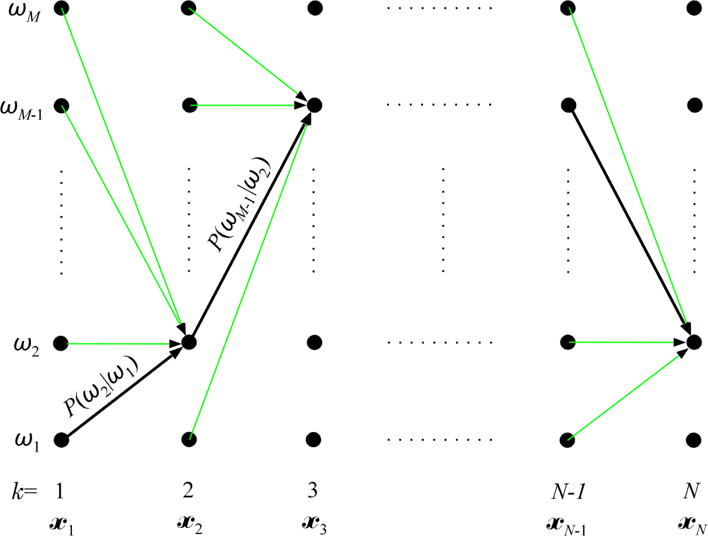
Viterbi Algorithm: Calculate p(X|Ω_{i})p(Ω_{i})
    Total M nodes in each of N columns
    Each node has M transitions
    Thus, complexity is O (NM²)

Slide 5
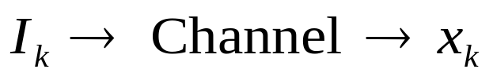
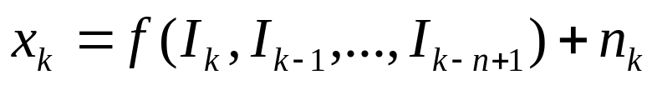
Application in Channel Equalization
The problem
  Information bits I_{k} are transmitted
  We receive x_{k}
    where, f is the action of channel
    n_{k} is the noise

Slide 6
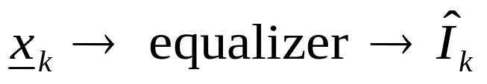
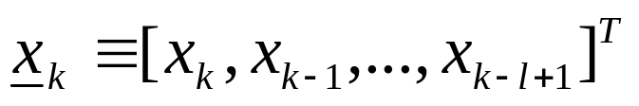
Application in Channel Equalization
We want the bits back
where,

Slide 7
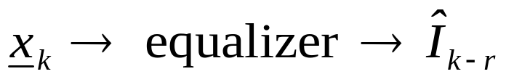
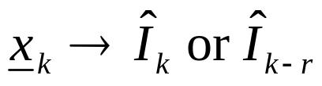
Application in Channel Equalization
We want the bits back
OR if we allow delay r

Slide 8

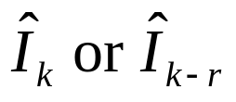
Application in Channel Equalization
We want the bits back
OR if we allow delay r
This means we use the vector to get a single bit

Slide 9
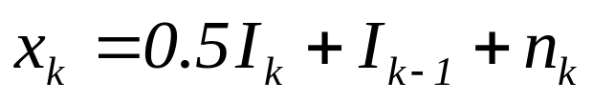
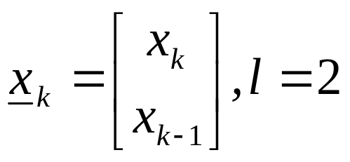
Application in Channel Equalization
Example
    In vector x_{k} three input symbols are involved:
    I_{k}, I_{k-1}, I_{k-2}

Slide 10

Application in Channel Equalization
Assuming n_{k} =0
I_{k} | I_{k-1} | I_{k-2}
0 | 0 | 0
0 | 0 | 1
0 | 1 | 0
0 | 1 | 1
1 | 0 | 0
1 | 0 | 1
1 | 1 | 0
1 | 1 | 1

Slide 11
Application in Channel Equalization
Assuming n_{k} =0
 |  | I_{k-2}
 |  | 0
 |  | 1
 |  | 0
 |  | 1
 |  | 0
 |  | 1
 |  | 0
 |  | 1

Slide 12
Application in Channel Equalization
Assuming n_{k} =0
 | I_{k-1} | I_{k-2}
 | 0 | 0
 | 0 | 1
 | 1 | 0
 | 1 | 1
 | 0 | 0
 | 0 | 1
 | 1 | 0
 | 1 | 1

Slide 13
Application in Channel Equalization
Assuming n_{k} =0
I_{k} | I_{k-1} | I_{k-2}
0 | 0 | 0
0 | 0 | 1
0 | 1 | 0
0 | 1 | 1
1 | 0 | 0
1 | 0 | 1
1 | 1 | 0
1 | 1 | 1

Slide 14


Application in Channel Equalization
Assuming n_{k} =0
 | I_{k-1} | I_{k-2} |  | x_{k-1}
0 | 0 | 0 | 0 | 0 | ω₁
0 | 0 | 1 | 0 | 1 | ω₂
0 | 1 | 0 | 1 | 0.5 | ω₃
0 | 1 | 1 | 1 | 1.5 | ω₄
1 | 0 | 0 | 0.5 | 0 | ω₅
1 | 0 | 1 | 0.5 | 1 | ω₆
1 | 1 | 0 | 1.5 | 0.5 | ω₇
1 | 1 | 1 | 1.5 | 1.5 | ω₈

Slide 15


Application in Channel Equalization
Assuming n_{k} =0
I_{k} | I_{k-1} | I_{k-2} | x_{k} | x_{k-1}
0 | 0 | 0 | 0 | 0 | ω₁
0 | 0 | 1 | 0 | 1 | ω₂
0 | 1 | 0 | 1 | 0.5 | ω₃
0 | 1 | 1 | 1 | 1.5 | ω₄
1 | 0 | 0 | 0.5 | 0 | ω₅
1 | 0 | 1 | 0.5 | 1 | ω₆
1 | 1 | 0 | 1.5 | 0.5 | ω₇
1 | 1 | 1 | 1.5 | 1.5 | ω₈

Slide 16
Application in Channel Equalization
Assuming n_{k} =0
Estimate I_{k} from (x_{k}, x_{k-1})
I_{k} | I_{k-1} | I_{k-2} | x_{k} | x_{k-1}
0 | 0 | 0 | 0 | 0 | ω₁
0 | 0 | 1 | 0 | 1 | ω₂
0 | 1 | 0 | 1 | 0.5 | ω₃
0 | 1 | 1 | 1 | 1.5 | ω₄
1 | 0 | 0 | 0.5 | 0 | ω₅
1 | 0 | 1 | 0.5 | 1 | ω₆
1 | 1 | 0 | 1.5 | 0.5 | ω₇
1 | 1 | 1 | 1.5 | 1.5 | ω₈

Slide 17
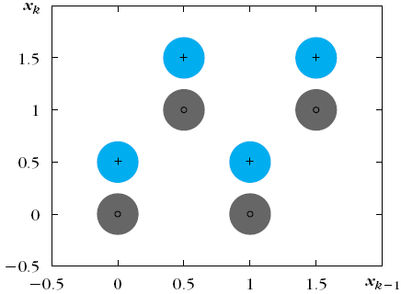
Application in Channel Equalization
Assuming n_{k} =0
I_{k} | I_{k-1} | I_{k-2} | x_{k} | x_{k-1}
0 | 0 | 0 | 0 | 0 | ω₁
0 | 0 | 1 | 0 | 1 | ω₂
0 | 1 | 0 | 1 | 0.5 | ω₃
0 | 1 | 1 | 1 | 1.5 | ω₄
1 | 0 | 0 | 0.5 | 0 | ω₅
1 | 0 | 1 | 0.5 | 1 | ω₆
1 | 1 | 0 | 1.5 | 0.5 | ω₇
1 | 1 | 1 | 1.5 | 1.5 | ω₈
+
+
_{º}
_{º}
+
+
_{º}
_{º}
Eight possible clusters

Slide 18
Application in Channel Equalization
Assuming n_{k} =0
I_{k} | I_{k-1} | I_{k-2} | x_{k} | x_{k-1}
0 | 0 | 0 | 0 | 0 | ω₁
0 | 0 | 1 | 0 | 1 | ω₂
0 | 1 | 0 | 1 | 0.5 | ω₃
0 | 1 | 1 | 1 | 1.5 | ω₄
1 | 0 | 0 | 0.5 | 0 | ω₅
1 | 0 | 1 | 0.5 | 1 | ω₆
1 | 1 | 0 | 1.5 | 0.5 | ω₇
1 | 1 | 1 | 1.5 | 1.5 | ω₈
+
+
_{º}
_{º}
+
+
_{º}
_{º}
‘+’ means I_{k} was 1, ‘o’ means I_{k} was 0

Slide 19
Application in Channel Equalization
I_{k} | I_{k-1} | I_{k-2} | x_{k} | x_{k-1}
0 | 0 | 0 | 0 | 0 | ω₁
0 | 0 | 1 | 0 | 1 | ω₂
0 | 1 | 0 | 1 | 0.5 | ω₃
0 | 1 | 1 | 1 | 1.5 | ω₄
1 | 0 | 0 | 0.5 | 0 | ω₅
1 | 0 | 1 | 0.5 | 1 | ω₆
1 | 1 | 0 | 1.5 | 0.5 | ω₇
1 | 1 | 1 | 1.5 | 1.5 | ω₈
Big cluster exists when the noise n_{k} is NOT 0 (zero)

Slide 20
Application in Channel Equalization
I_{k} | I_{k-1} | I_{k-2} | x_{k} | x_{k-1}
0 | 0 | 0 | 0 | 0 | ω₁
0 | 0 | 1 | 0 | 1 | ω₂
0 | 1 | 0 | 1 | 0.5 | ω₃
0 | 1 | 1 | 1 | 1.5 | ω₄
1 | 0 | 0 | 0.5 | 0 | ω₅
1 | 0 | 1 | 0.5 | 1 | ω₆
1 | 1 | 0 | 1.5 | 0.5 | ω₇
1 | 1 | 1 | 1.5 | 1.5 | ω₈
Estimate from (x_{k}, x_{k-1})
A two class problem
Each class is a union of clusters

Slide 21
Solution (1)
I_{k} | I_{k-1} | I_{k-2} | x_{k} | x_{k-1}
0 | 0 | 0 | 0 | 0 | ω₁
0 | 0 | 1 | 0 | 1 | ω₂
0 | 1 | 0 | 1 | 0.5 | ω₃
0 | 1 | 1 | 1 | 1.5 | ω₄
1 | 0 | 0 | 0.5 | 0 | ω₅
1 | 0 | 1 | 0.5 | 1 | ω₆
1 | 1 | 0 | 1.5 | 0.5 | ω₇
1 | 1 | 1 | 1.5 | 1.5 | ω₈
During training,
  send all values of (I_{k-2}, I_{k-1}, I_{k}) and calculate (x_{k-1}, x_{k})
  Calculate the cluster centers μ_{k}
  Assign the bit I_{k} to the cluster μ_{k}

Slide 22
Solution (1)
I_{k} | I_{k-1} | I_{k-2} | x_{k} | x_{k-1}
? |  |  | 0 | 0 | ω₁
? |  |  | 0 | 1 | ω₂
? |  |  | 1 | 0.5 | ω₃
? |  |  | 1 | 1.5 | ω₄
? |  |  | 0.5 | 0 | ω₅
? |  |  | 0.5 | 1 | ω₆
? |  |  | 1.5 | 0.5 | ω₇
? |  |  | 1.5 | 1.5 | ω₈
During equalization (testing),
  Get (x_{k-1}, x_{k}) from the channel
  Find the nearest cluster μ_{i}
  The bit of μ_{i} is the estimated transmitted bit

Slide 23

Solution (2)
I_{k} | I_{k-1} | I_{k-2} | x_{k} | x_{k-1}
0 | 0 | 0 | 0 | 0 | ω₁
0 | 0 | 1 | 0 | 1 | ω₂
0 | 1 | 0 | 1 | 0.5 | ω₃
0 | 1 | 1 | 1 | 1.5 | ω₄
1 | 0 | 0 | 0.5 | 0 | ω₅
1 | 0 | 1 | 0.5 | 1 | ω₆
1 | 1 | 0 | 1.5 | 0.5 | ω₇
1 | 1 | 1 | 1.5 | 1.5 | ω₈
Let
  which corresponds to ω₂

Slide 24
Solution (2)
I_{k} | I_{k-1} | I_{k-2} | x_{k} | x_{k-1}
0 | 0 | 0 | 0 | 0 | ω₁
0 | 0 | 1 | 0 | 1 | ω₂
0 | 1 | 0 | 1 | 0.5 | ω₃
0 | 1 | 1 | 1 | 1.5 | ω₄
1 | 0 | 0 | 0.5 | 0 | ω₅
1 | 0 | 1 | 0.5 | 1 | ω₆
1 | 1 | 0 | 1.5 | 0.5 | ω₇
1 | 1 | 1 | 1.5 | 1.5 | ω₈
Let
  which corresponds to ω₂

Slide 25
Solution (2)
I_{k+1} | I_{k} | I_{k-1} | I_{k-2} | x_{k} | x_{k-1}
? | 0 | 0 | 0 | 0 | 0 | ω₁
? | 0 | 0 | 1 | 0 | 1 | ω₂
? | 0 | 1 | 0 | 1 | 0.5 | ω₃
? | 0 | 1 | 1 | 1 | 1.5 | ω₄
? | 1 | 0 | 0 | 0.5 | 0 | ω₅
? | 1 | 0 | 1 | 0.5 | 1 | ω₆
? | 1 | 1 | 0 | 1.5 | 0.5 | ω₇
? | 1 | 1 | 1 | 1.5 | 1.5 | ω₈
Let
  which corresponds to ω₂
What will be the next bit I_{k+1}

Slide 26

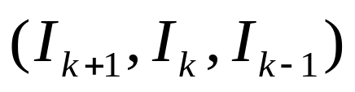
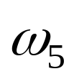


Solution (2)
I_{k+1} | I_{k} | I_{k-1} | I_{k-2} | x_{k} | x_{k-1}
? | 0 | 0 | 0 | 0 | 0 | ω₁
0, 1 | 0 | 0 | 1 | 0 | 1 | ω₂
? | 0 | 1 | 0 | 1 | 0.5 | ω₃
? | 0 | 1 | 1 | 1 | 1.5 | ω₄
? | 1 | 0 | 0 | 0.5 | 0 | ω₅
? | 1 | 0 | 1 | 0.5 | 1 | ω₆
? | 1 | 1 | 0 | 1.5 | 0.5 | ω₇
? | 1 | 1 | 1 | 1.5 | 1.5 | ω₈
Let
  which corresponds to ω₂
The next bit I_{k+1} can be either 1 or 0

Slide 27
Solution (2)
I_{k+1} | I_{k} | I_{k-1} | I_{k-2} | x_{k} | x_{k-1}
? | 0 | 0 | 0 | 0 | 0 | ω₁
0, 1 | 0 | 0 | 1 | 0 | 1 | ω₂
? | 0 | 1 | 0 | 1 | 0.5 | ω₃
? | 0 | 1 | 1 | 1 | 1.5 | ω₄
? | 1 | 0 | 0 | 0.5 | 0 | ω₅
? | 1 | 0 | 1 | 0.5 | 1 | ω₆
? | 1 | 1 | 0 | 1.5 | 0.5 | ω₇
? | 1 | 1 | 1 | 1.5 | 1.5 | ω₈
This means, all transitions are not possible!!
In other words, after (0, 0, 1) we will find
either (1, 0, 0)
or (0, 0, 0)

Slide 28
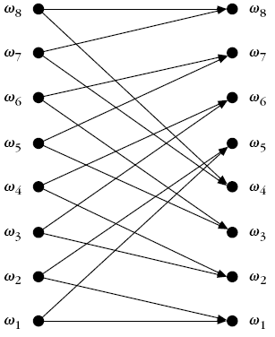
Solution (2)
I_{k+1} | I_{k} | I_{k-1} | I_{k-2} | x_{k} | x_{k-1}
0, 1 | 0 | 0 | 0 | 0 | 0 | ω₁
0, 1 | 0 | 0 | 1 | 0 | 1 | ω₂
0, 1 | 0 | 1 | 0 | 1 | 0.5 | ω₃
0, 1 | 0 | 1 | 1 | 1 | 1.5 | ω₄
0, 1 | 1 | 0 | 0 | 0.5 | 0 | ω₅
0, 1 | 1 | 0 | 1 | 0.5 | 1 | ω₆
0, 1 | 1 | 1 | 0 | 1.5 | 0.5 | ω₇
0, 1 | 1 | 1 | 1 | 1.5 | 1.5 | ω₈
This means, all transitions are NOT possible!!
Alternately, after (0, 0, 1) we can get either (1, 0, 0) or (0, 0,0)

Slide 29
Solution (2)
I_{k+1} | I_{k} | I_{k-1} | I_{k-2} | x_{k} | x_{k-1}
0, 1 | 0 | 0 | 0 | 0 | 0 | ω₁
0, 1 | 0 | 0 | 1 | 0 | 1 | ω₂
0, 1 | 0 | 1 | 0 | 1 | 0.5 | ω₃
0, 1 | 0 | 1 | 1 | 1 | 1.5 | ω₄
0, 1 | 1 | 0 | 0 | 0.5 | 0 | ω₅
0, 1 | 1 | 0 | 1 | 0.5 | 1 | ω₆
0, 1 | 1 | 1 | 0 | 1.5 | 0.5 | ω₇
0, 1 | 1 | 1 | 1 | 1.5 | 1.5 | ω₈
We can use Viterbi algorithm now !!!

Slide 30
Solution (2): Viterbi Algorithm
I_{k+1} | I_{k} | I_{k-1} | I_{k-2} | x_{k} | x_{k-1}
0, 1 | 0 | 0 | 0 | 0 | 0 | ω₁
0, 1 | 0 | 0 | 1 | 0 | 1 | ω₂
0, 1 | 0 | 1 | 0 | 1 | 0.5 | ω₃
0, 1 | 0 | 1 | 1 | 1 | 1.5 | ω₄
0, 1 | 1 | 0 | 0 | 0.5 | 0 | ω₅
0, 1 | 1 | 0 | 1 | 0.5 | 1 | ω₆
0, 1 | 1 | 1 | 0 | 1.5 | 0.5 | ω₇
0, 1 | 1 | 1 | 1 | 1.5 | 1.5 | ω₈
We need to define:
P(ω_{i}| ω_{j})
Cost function

Slide 31
Solution (2): Viterbi Algorithm
I_{k+1} | I_{k} | I_{k-1} | I_{k-2} | x_{k} | x_{k-1}
0, 1 | 0 | 0 | 0 | 0 | 0 | ω₁
0, 1 | 0 | 0 | 1 | 0 | 1 | ω₂
0, 1 | 0 | 1 | 0 | 1 | 0.5 | ω₃
0, 1 | 0 | 1 | 1 | 1 | 1.5 | ω₄
0, 1 | 1 | 0 | 0 | 0.5 | 0 | ω₅
0, 1 | 1 | 0 | 1 | 0.5 | 1 | ω₆
0, 1 | 1 | 1 | 0 | 1.5 | 0.5 | ω₇
0, 1 | 1 | 1 | 1 | 1.5 | 1.5 | ω₈
Assuming equiprobability of the next bit:
  P(ω₁| ω₁) = 0.5 = P(ω₁| ω₅)

Slide 32



Solution (2): Viterbi Algorithm
Cost function of transition
Where, either Euclidean distance
Or Mahalanobis distance
Can be used

Slide 33
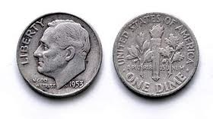
Hidden Markov Model

Slide 34
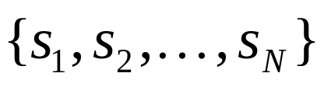
Markov Models
Set of states:

Slide 35
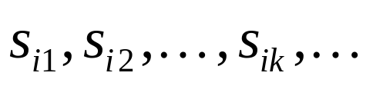
Markov Models
Set of states:
Process moves from one state to another generating a sequence of states :

Slide 36
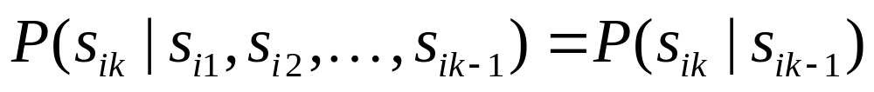
Markov Models
Set of states:
Process moves from one state to another generating a sequence of states :
Markov chain property: probability of each subsequent state depends only on what was the previous state:

Slide 37
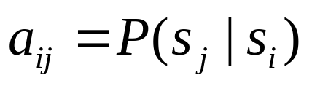
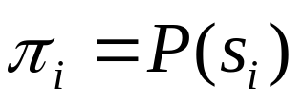
Markov Models
Set of states:
Process moves from one state to another generating a sequence of states :
Markov chain property: probability of each subsequent state depends only on what was the previous state:
To define Markov model, the following probabilities have to be specified: transition probabilities and initial probabilities

Slide 38
Example of Markov Model
0.3
0.7
Rain
Dry
0.2
0.8

Slide 39
Example of Markov Model
0.3
0.7
Rain
Dry
0.2
0.8
Two states : ‘Rain’ and ‘Dry’.

Slide 40
Example of Markov Model
0.3
0.7
Rain
Dry
0.2
0.8
Two states : ‘Rain’ and ‘Dry’.
Transition probabilities:
  P(‘Rain’|‘Rain’)=0.3 , P(‘Dry’|‘Rain’)=0.7 ,
  P(‘Rain’|‘Dry’)=0.2, P(‘Dry’|‘Dry’)=0.8

Slide 41
Example of Markov Model
0.3
0.7
Rain
Dry
0.2
0.8
Two states : ‘Rain’ and ‘Dry’.
Transition probabilities:
  P(‘Rain’|‘Rain’)=0.3 , P(‘Dry’|‘Rain’)=0.7 ,
  P(‘Rain’|‘Dry’)=0.2, P(‘Dry’|‘Dry’)=0.8
Initial probabilities: say P(‘Rain’)=0.4 , P(‘Dry’)=0.6 .

Slide 42
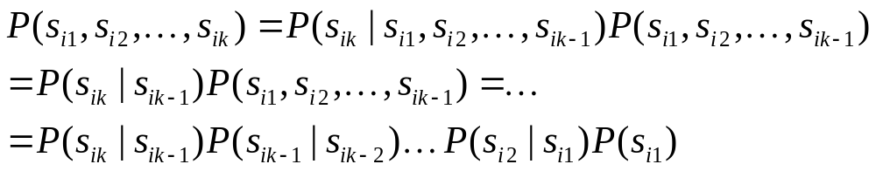
Calculation of sequence probability
By Markov chain property, probability of state sequence can be found by the formula:

Slide 43
Calculation of sequence probability
0.3
0.7
Rain
Dry
0.2
0.8
Suppose we want to calculate a probability of a sequence of states in our example, {‘Dry’,’Dry’,’Rain’,Rain’}.
P({‘Dry’,’Dry’,’Rain’,Rain’} )

Slide 44
Calculation of sequence probability
0.3
0.7
Rain
Dry
0.2
0.8
Suppose we want to calculate a probability of a sequence of states in our example, {‘Dry’,’Dry’,’Rain’,Rain’}.
P({‘Dry’,’Dry’,’Rain’,Rain’} )
= P(‘Rain’|’Rain’) P(‘Rain’|’Dry’) P(‘Dry’|’Dry’) P(‘Dry’)

Slide 45
Calculation of sequence probability
0.3
0.7
Rain
Dry
0.2
0.8
Suppose we want to calculate a probability of a sequence of states in our example, {‘Dry’,’Dry’,’Rain’,Rain’}.
P({‘Dry’,’Dry’,’Rain’,Rain’} )
= P(‘Rain’|’Rain’) P(‘Rain’|’Dry’) P(‘Dry’|’Dry’) P(‘Dry’)
= 0.3*0.2*0.8*0.6

Slide 46
Hidden Markov Model

Slide 47
Hidden Markov Model

Slide 48
Hidden Markov Model
H T H H T T T H H H . . . . .

Slide 49
Hidden Markov Model
H T H H T T T H H H . . . . .
Can we guess which coin is tossed at different times?

Slide 50
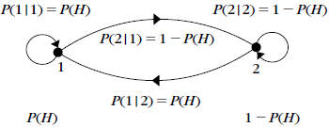
Not A Hidden Markov Model

Slide 51
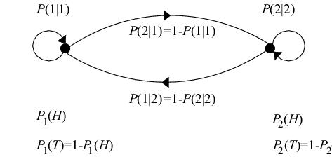
Hidden Markov Model

Slide 52
Hidden Markov models
Set of states:
Process moves from one state to another generating a sequence of states :
Markov chain property: probability of each subsequent state depends only on what was the previous state:

Slide 53
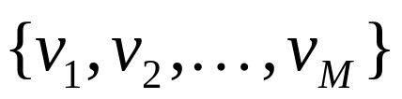
Hidden Markov models
States are not visible, but each state randomly generates one of M observations (or visible states)

Slide 54
Hidden Markov models
States are not visible, but each state randomly generates one of M observations (or visible states)
To define hidden Markov model, the following probabilities have to be specified:
  matrix of transition probabilities A=(a_{ij}), a_{ij}= P(s_{j} | s_{i})
  matrix of observation probabilities B=(b_{i} (v_{m} )),
  where, b_{i}(v_{m} ) =P(v_{m}|s_{i})
  vector of initial probabilities π=(π_{i}), π_{i} = P(s_{i})
Model is represented by M=(A, B, π).

Slide 55
Example of Hidden Markov Model
0.3
0.7
Low
High
0.2
0.8
0.6
0.6
0.4
0.4
Rain
Dry

Slide 56
Example of Hidden Markov Model
0.3
0.7
Low
High
0.2
0.8
0.6
0.6
0.4
0.4
Rain
Dry
Initial probabilities: say P(‘Low’)=0.4 , P(‘High’)=0.6 .

Slide 57
Example of Hidden Markov Model
Two states : ‘Low’ and ‘High’ atmospheric pressure.
Two observations : ‘Rain’ and ‘Dry’.
Transition probabilities: P(‘Low’|‘Low’)=0.3 , P(‘High’|‘Low’)=0.7 , P(‘Low’|‘High’)=0.2, P(‘High’|‘High’)=0.8
Observation probabilities : P(‘Rain’|‘Low’)=0.6 , P(‘Dry’|‘Low’)=0.4 , P(‘Rain’|‘High’)=0.4 , P(‘Dry’|‘High’)=0.3 .
Initial probabilities: say P(‘Low’)=0.4 , P(‘High’)=0.6 .

Slide 58
Calculation of observation sequence probability
Suppose we want to calculate a probability of a sequence of observations in our example, {‘Dry’,’Rain’}.
Consider all possible hidden state sequences:
P({‘Dry’,’Rain’} ) = P({‘Dry’,’Rain’} , {‘Low’,’Low’})
+P({‘Dry’,’Rain’} , {‘Low’,’High’})
+ P({‘Dry’,’Rain’} , {‘High’,’Low’})
+ P({‘Dry’,’Rain’} , {‘High’,’High’})

Slide 59
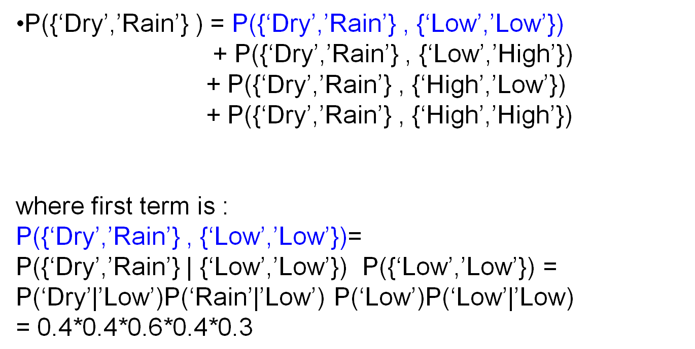
Calculation of observation sequence probability

Slide 60
Main issues using HMMs
Evaluation problem.
Given the HMM M=(A, B, π) and the observation sequence O=o₁ o₂ ... o_{K} , calculate the probability that model M has generated sequence O .
O=o₁...o_{K} denotes a sequence of observations o_{k}∈{v₁,…,v_{M}}.

Slide 61
Main issues using HMMs
Decoding problem.
Given the HMM M=(A, B, π) and the observation sequence O=o₁ o₂ ... o_{K} , calculate the most likely sequence of hidden states s_{i} that produced this observation sequence O.
O=o₁...o_{K} denotes a sequence of observations o_{k}∈{v₁,…,v_{M}}.

Slide 62
Main issues using HMMs
Learning problem.
Given some training observation sequences O=o₁ o₂ ... o_{K} and general structure of HMM (numbers of hidden and visible states), determine HMM parameters M=(A, B, π) that best fit training data.
O=o₁...o_{K} denotes a sequence of observations o_{k}∈{v₁,…,v_{M}}.

